Slide 1
Scrum-Agile Model vs. Waterfall Model

Slide 2
The Scrum-Agile Team
Product Owner – accountable for the management, optimization, and presentation of the Product Backlog
Scrum Master – accountable for ensuring Scrum is understood and executed
Developer – accountable for developing and building a usable increment for each Sprint
Tester – accountable for developing and testing a usable increment for each Sprint

Slide 3

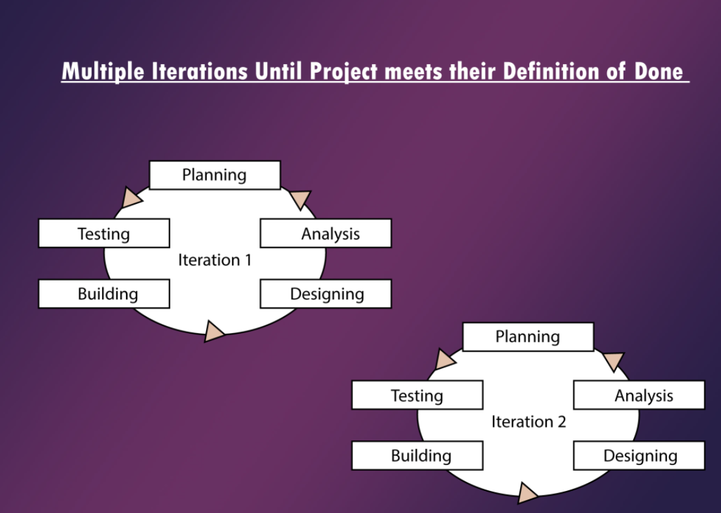
Agile Model Software Development Life Cycle
Dynamic Phases
Planning
Requirement Analysis
Design
Coding
Unit Testing
Acceptance Testing

Slide 4
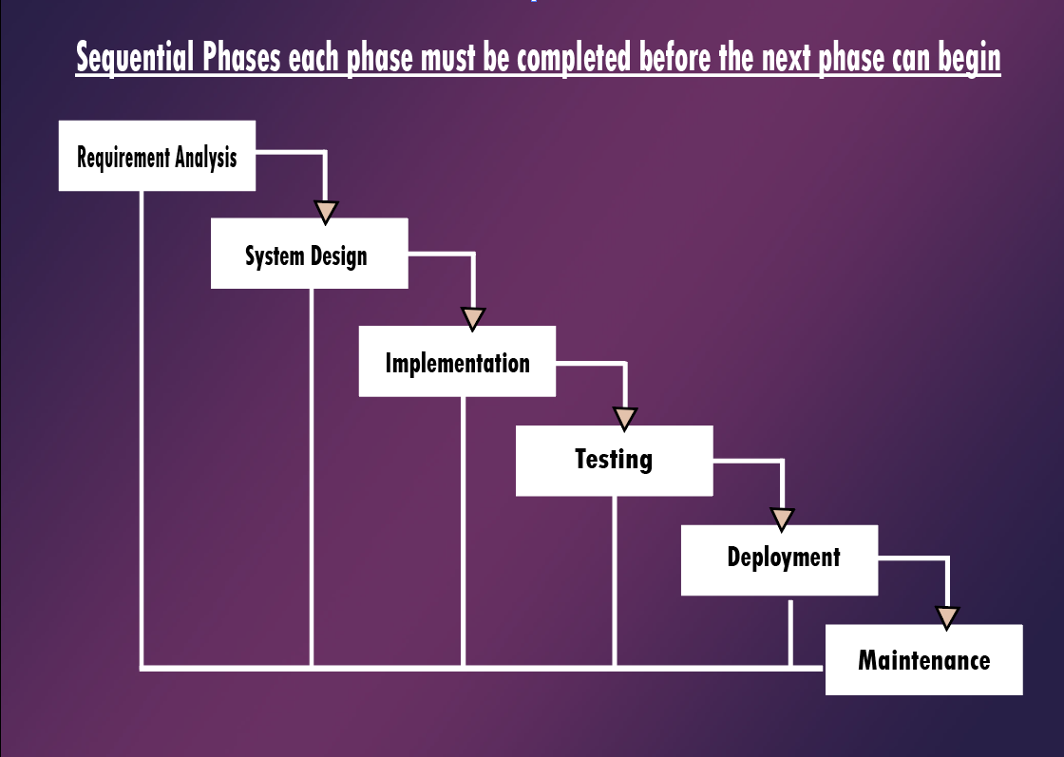
Waterfall Model Software Development Life Cycle
Sequential Phases
Requirement Analysis
System Design
Implementation
Integration and Testing
Deployment of system
Maintenance

Slide 5
Waterfall vs Scrum-Agile
Waterfall
Scrum-Agile
Requirement Analysis and Design done once in the beginning
Phases are sequential and done one at a time
Less interaction with client
No unexpected changes or updates
Clearly defined milestones
Individuals specialize in specific work
May have periods of time when individuals may not have work available
High level of risk and uncertainty
Requirement Analysis and Design done throughout the entire project
Phases are done incrementally and repeated throughout project
Feature driven development
Multiple meetings with client throughout project
Changes are encouraged and expected
Dynamic, Cross-functional team
Team members work and help each other throughout the project
Failure is encouraged, consequences are minimal due to short incremental phases

Slide 6
Waterfall or Scrum-Agile?
Waterfall
Scrum-Agile
Good for:
Small Projects
Project’s requirements are stable and well defined
Projects with minimal variable factors
Good for:
Large projects with high risk of change
Projects with many features
Projects with one product owner, product backlog, one team
Factors to consider:
Size of project
Size of team
Size of product backlog
Complexity of project
How defined is the project/product?

Slide 7
References
Agile SDLC (software development life cycle). GeeksforGeeks.
(2021, October 22). Retrieved October 23, 2021, from https://www.geeksforgeeks.org/agile-sdlc-software-development-life- cycle/.
Cobb, C. G. (2015). Project Manager's Guide to Mastering Agile: Principles and practices for an. John Wiley & Sons.
SDLC Tutorial. SDLC tutorial. (n.d.). Retrieved October 23, 2021, from https://www.tutorialspoint.com/sdlc/index.htm.
What is Scrum? Scrum.org. (n.d.). Retrieved October 23, 2021, from https://www.scrum.org/resources/what-is-scrum.

